Slide 1

xiayanliu@gmail.com
The ABS3 subfamily MATEs-mediated Senescence Pathway
Xiayan Liu
2023
Northwest A&F University, China
xiayanliu@gmail.com

Slide 2
Color of Autumn
NWAFU, South Campus

Slide 3
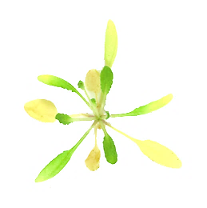
Plant as a model to study aging and longevity
Natural senescence
ABA
Ethylene
JA
SA
Nutrients
Newly growing and
Storage tissues
CK
GA
Stress-induced senescence

Slide 4
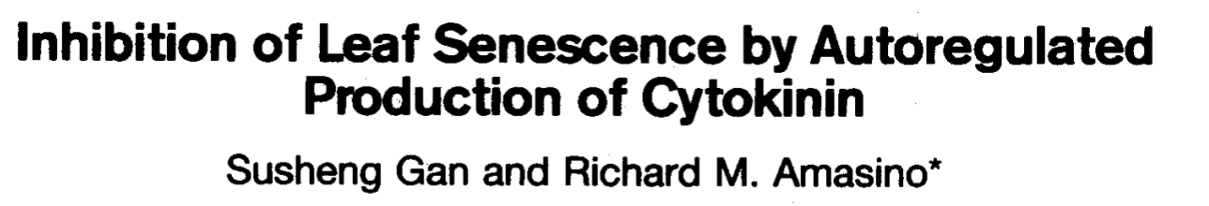
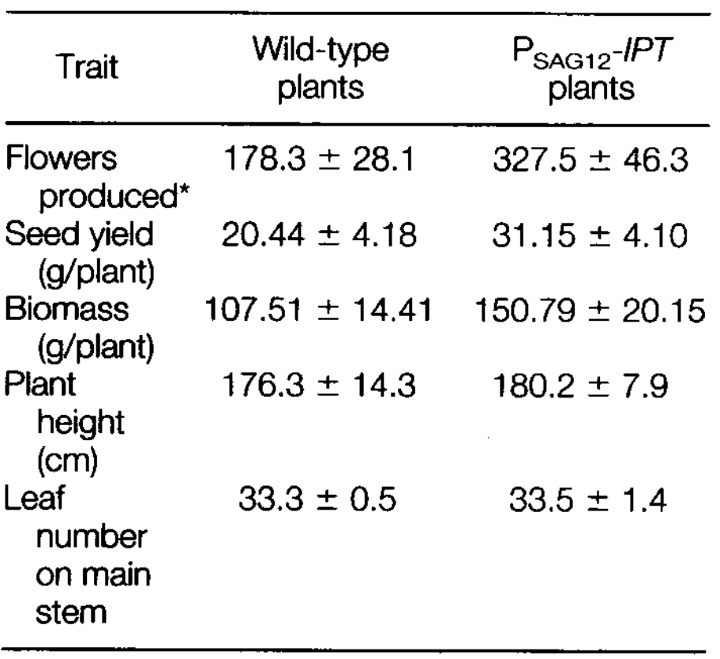
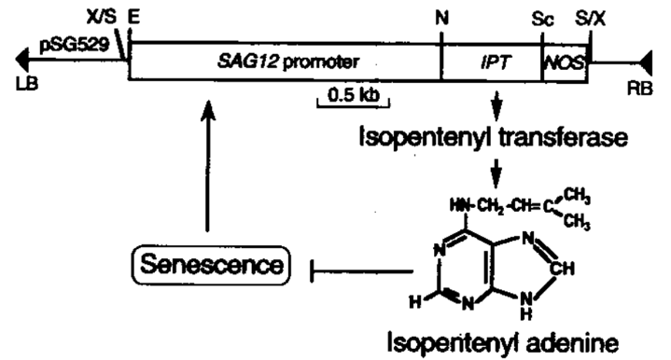
Senescence is an important agronomic trait
pSAG12:IPT to transform tobacco plants
Gan and Amasino, 1995, Science, 270, 1986-1988

Slide 5
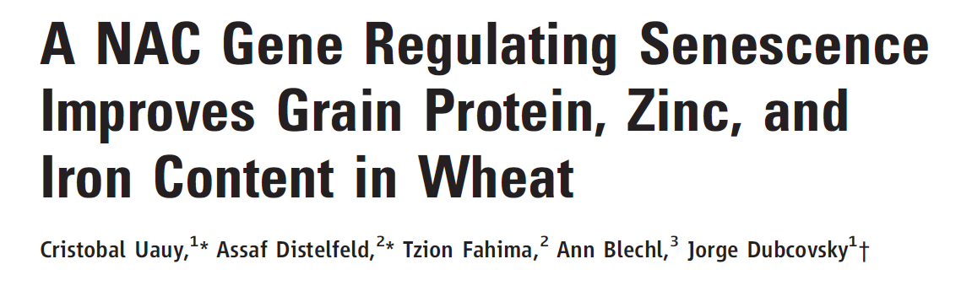
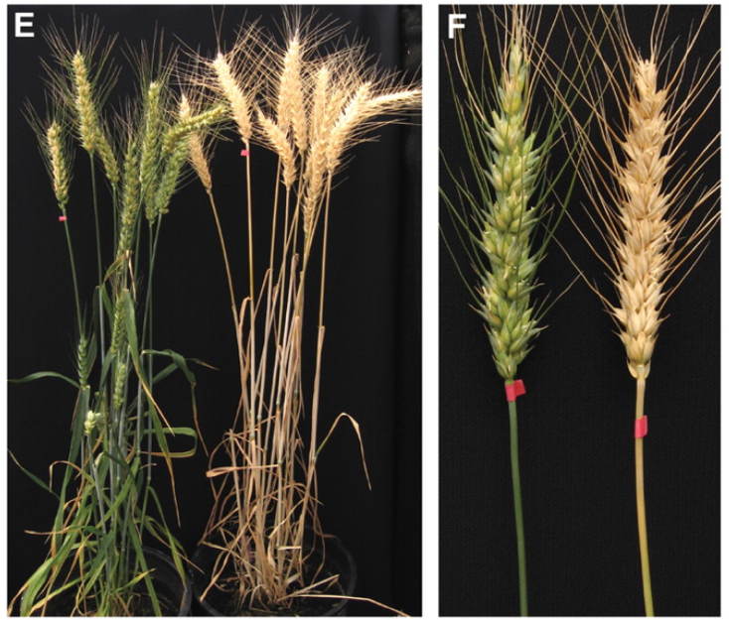
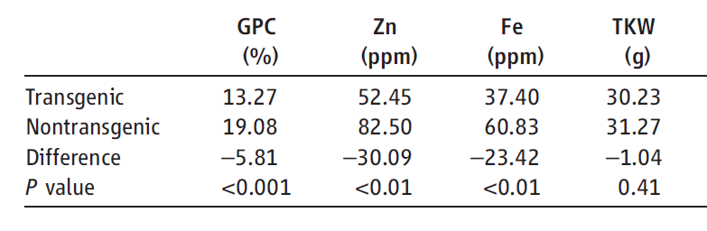
Senescence is an important agronomic trait
Silencing of TaNAM results in stay-green phenotype
and reduced remobilization of nutrients to the grains.
TaNAM RNAi
Control
Uauy et al., 2006, Science, 314, 1298-1301.

Slide 6
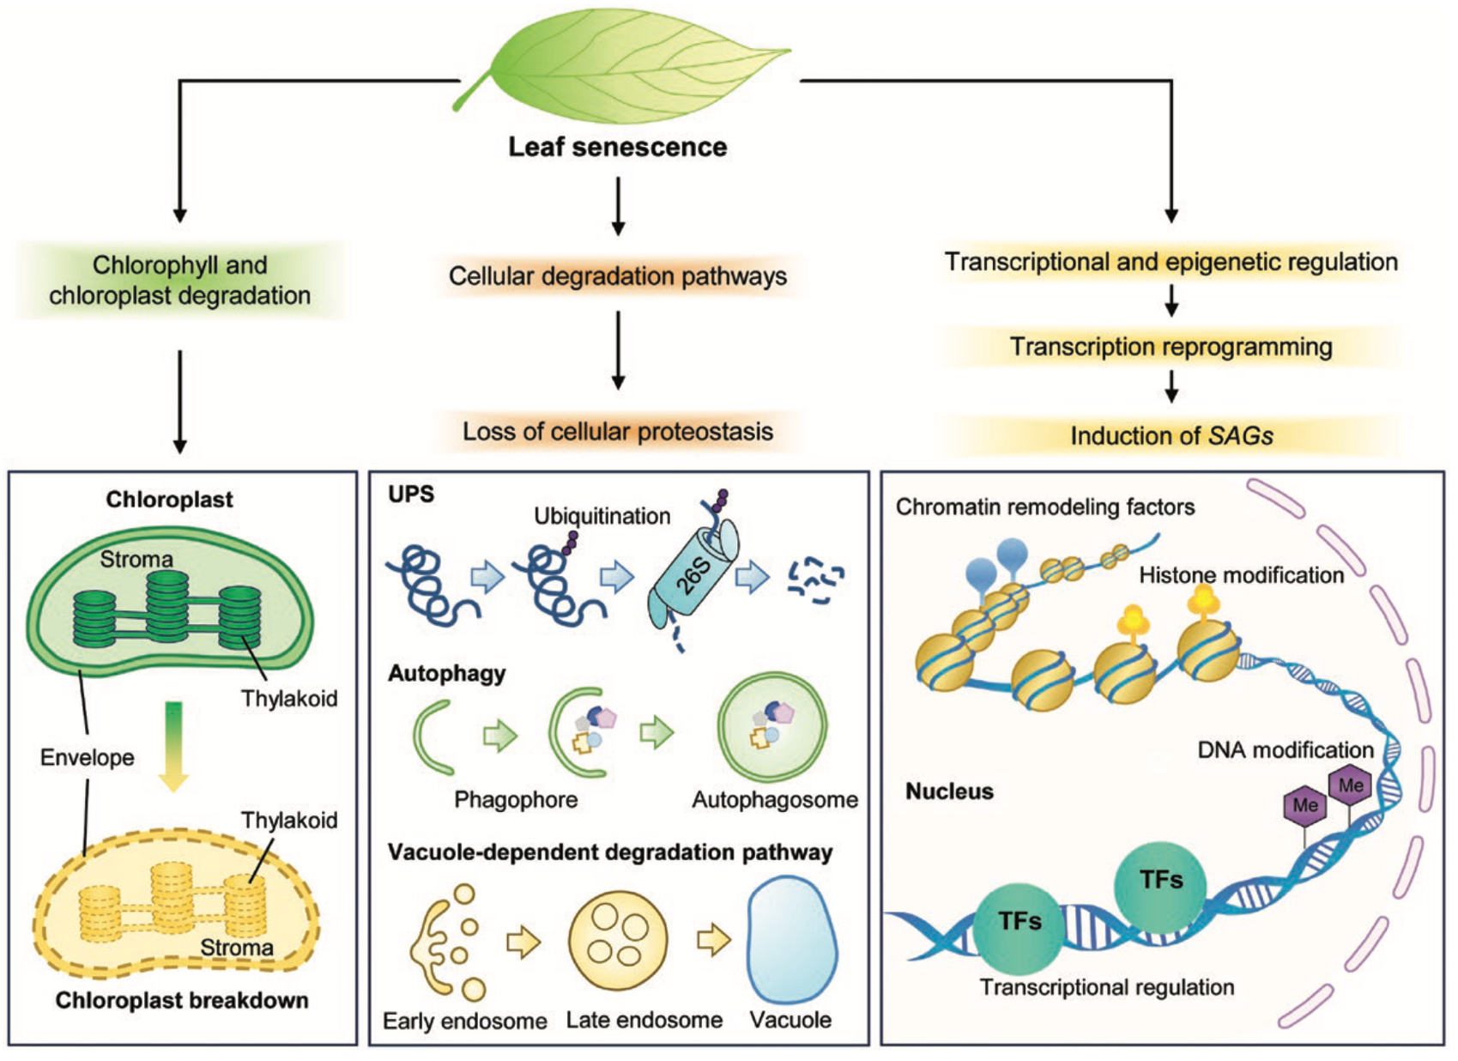
Hallmarks of Leaf Senescence
Lei et al., J Exp Bot 2023, 10.1093/jxb/erad273

Slide 7
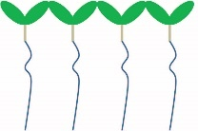
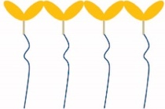

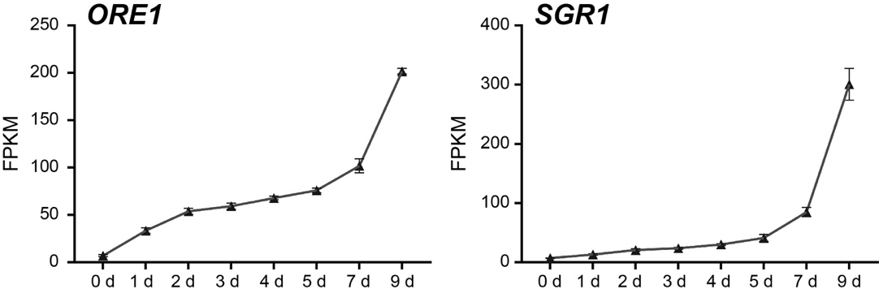
C-deprivation-induced senescence
C-deprivation
Transfer
Chlorophyll Breakdown
progressive protein loss
Induction of SAGs

Slide 8
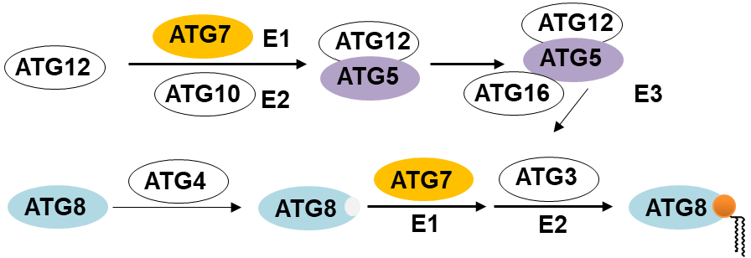
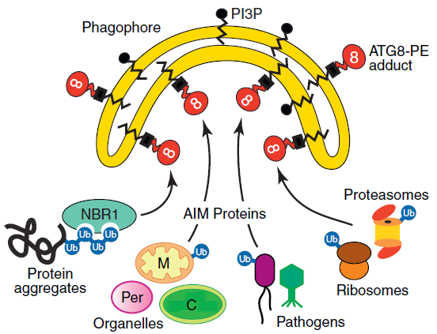
Autophagy mutants are hypersensitive to C-deprivation
Autophagy
senescence
Modified from Li et al., Trends Plant Sci 2012

Slide 9
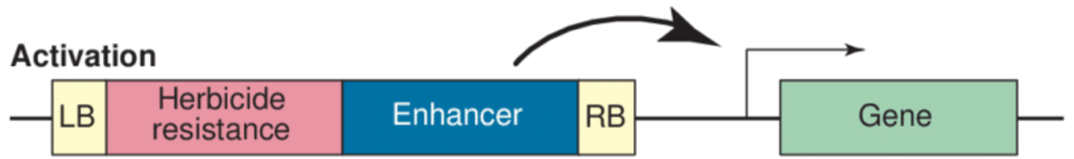
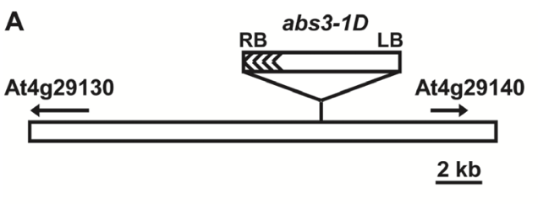
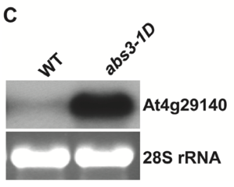
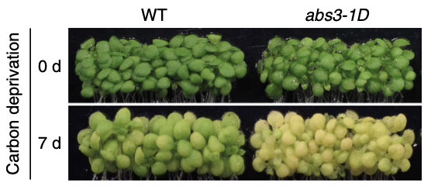

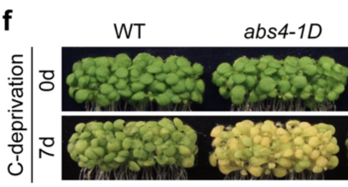
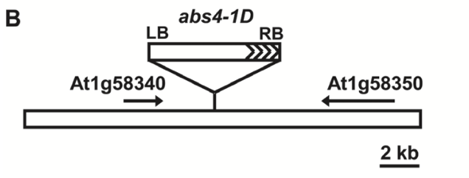
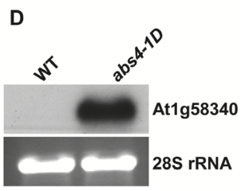
Activated expression of ABS3 or ABS4 accelerates senescence
WT
abs3-1D
WT
abs4-1D
Wang et al., 2015, J Exp Bot, 66, 6327-6343.
ABS3/At4g29140 and ABS4/At1g58340 encode closely related MATE family transporters

Slide 10
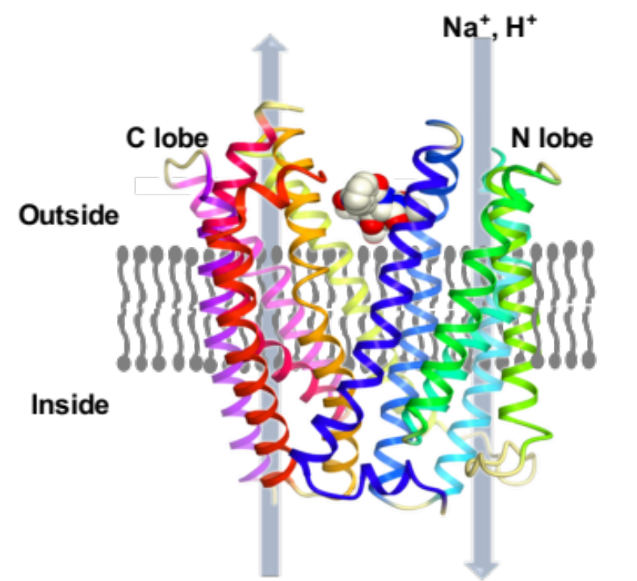
MATE Family Transporters
MATE transporter family
Multidrug And Toxic compound Extrusion family
Initially discovered in bacteria
Widely distributed in all kingdoms of living organisms
MATEs function as metabolic and xenobiotic organic cation exporters
MATE family greatly expanded in plant species
At least 56 MATE proteins in Arabidopsis
Tanaka et al., Nature, 2013, 496, 247-251.

Slide 11
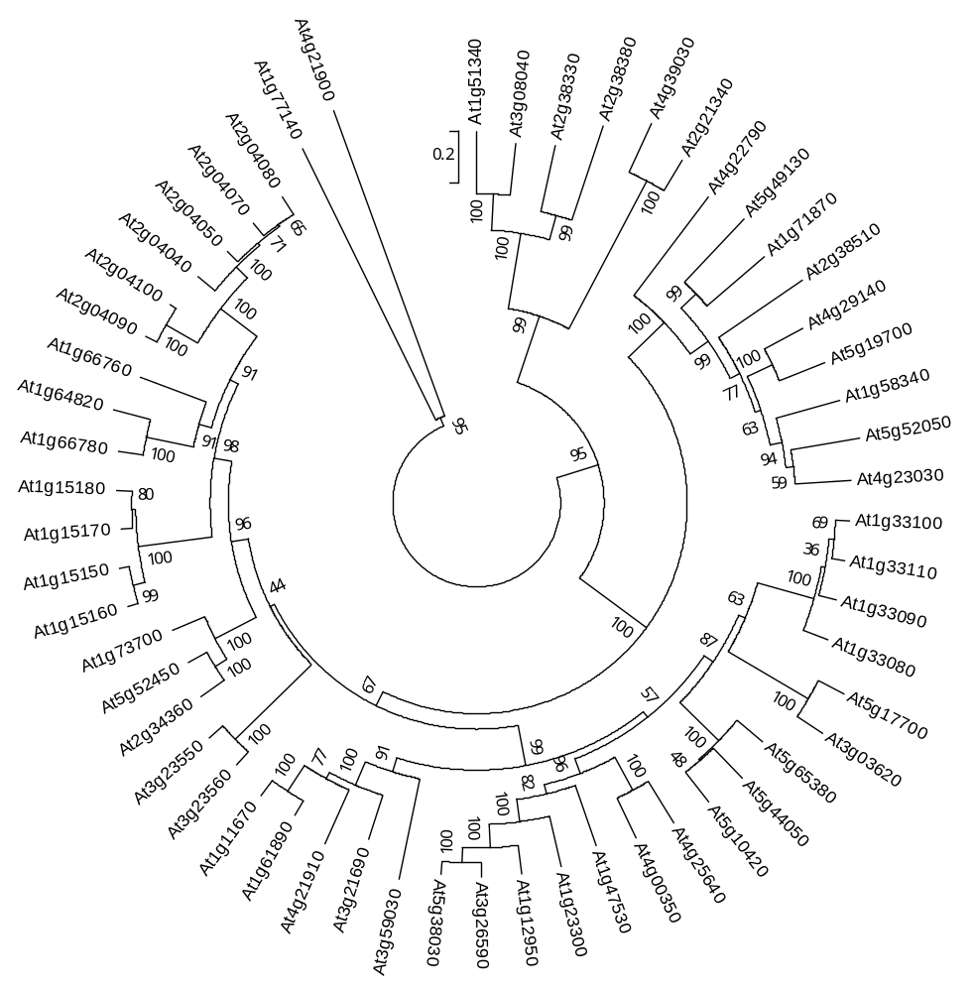
Arabidopsis Multidrug And Toxic Compound Extrusion (MATE) Transporter Family
ABS3
*
ABS3 subfamily
*
ABS4

Slide 12
Human MATEs are involved in the processing of diabetic drug metformin
https://www.pharmgkb.org/pathway/PA165948259

Slide 13
Plant MATE proteins have diverse functions and varied subcellular localizations
Gene Name | Function | Subcellular Localization | Potential Substrates | Reference
TRANSPARENT TESTA12 (TT12) | Proanthocyanidins accumulation in seed coat | Tonoplast | Flavonoids | Marinova et al., 2007
ABERRANT LATERAL ROOT FORMATION5 (ALF5) | Protect the roots from inhibitory compounds | N.A. | Tetramethylamonium | Diener et al., 2007
ENHANCED DISEASE SUSCEPTIBILITY5 (EDS5) | Plant defense | Chloroplast Envelope | SA or SA precursor | Nawrath et al., 2002; Serrano et al., 2003
Arabidopsis thaliana DETOXIFICATION1 (AtDTX1) | Efflux of toxic compounds from the cytoplasm | Plasma Membrane | Plant alkaloids | Li et al., 2002
FERRIC REDUCTASE DEFECTIVE3 (FRD3) | Iron homeostasis | Plasma Membrane | Citrate | Green et al., 2004 Roschzttardtz et al., 2011

Slide 14

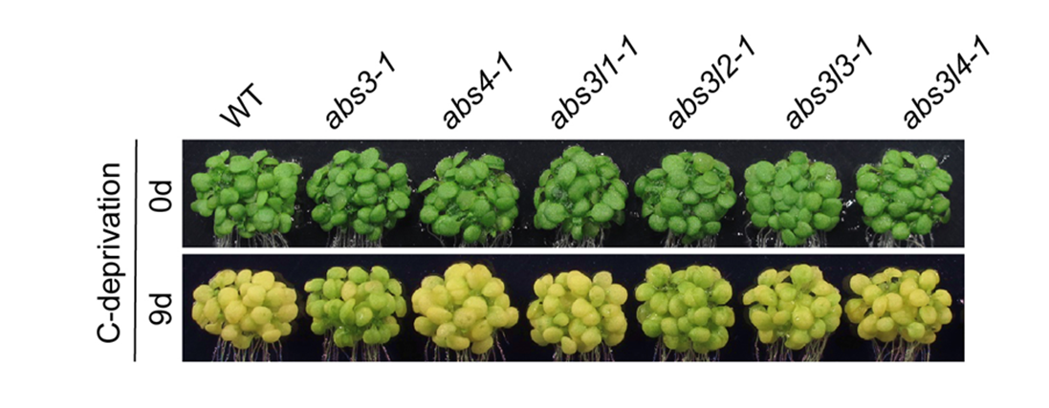
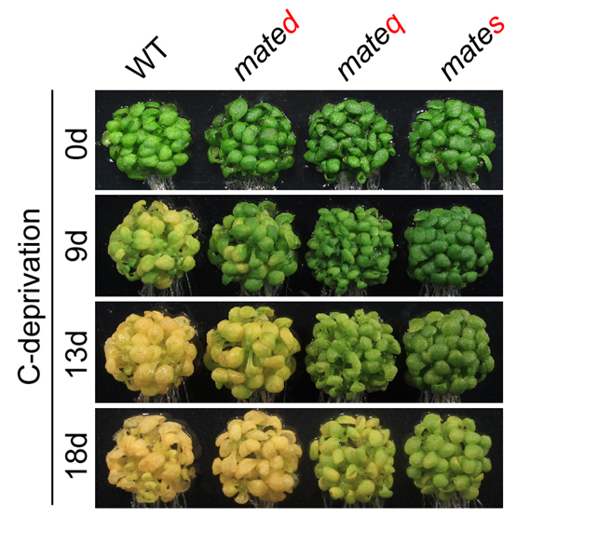
Loss of ABS3 subfamily MATEs delays senescence
mated:
abs3-1 abs4-1
mateq:
abs3-1 abs4-1
abs3l1-1 abs3l2-1
mates:
abs3-1 abs4-1
abs3l1-1 abs3l2-1 abs3l3-1 abs3l4-1

Slide 15
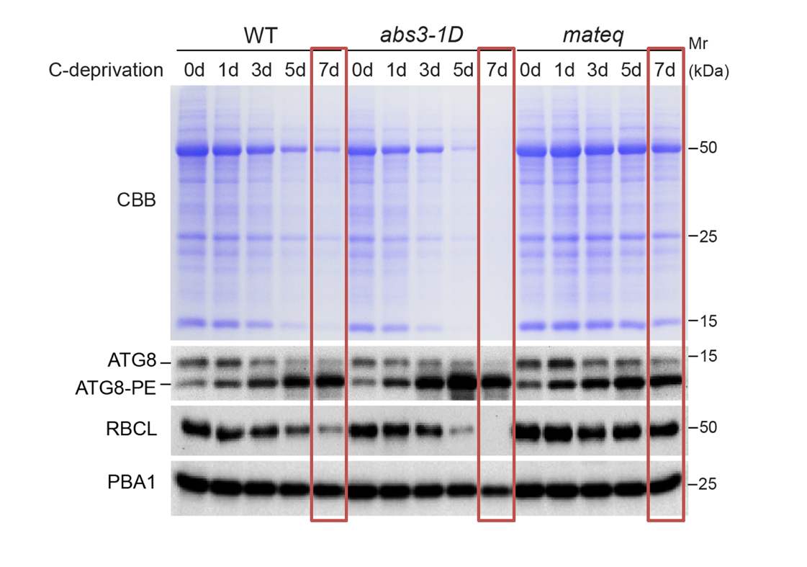
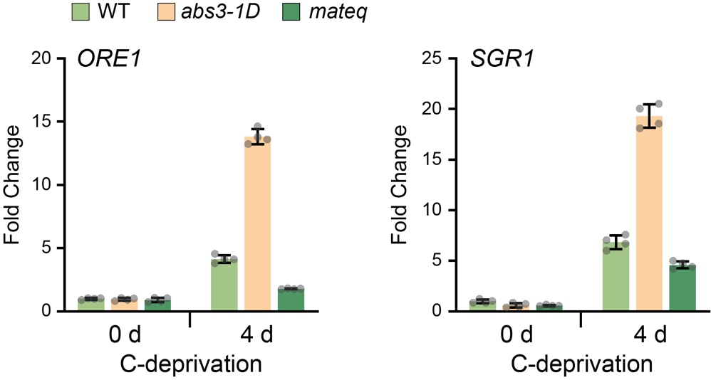
ABS3 promotes bulk protein degradation and induction of SAGs

Slide 16
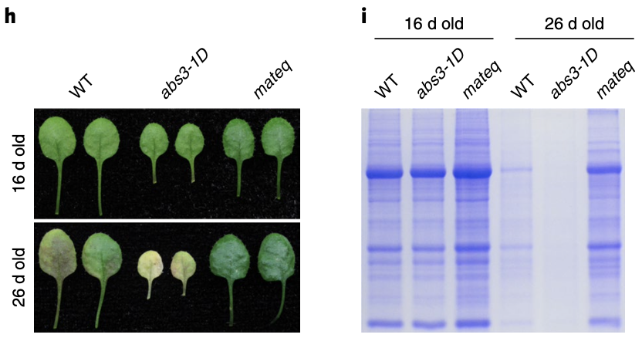
ABS3 subfamily MATEs promote natural senescence

Slide 17
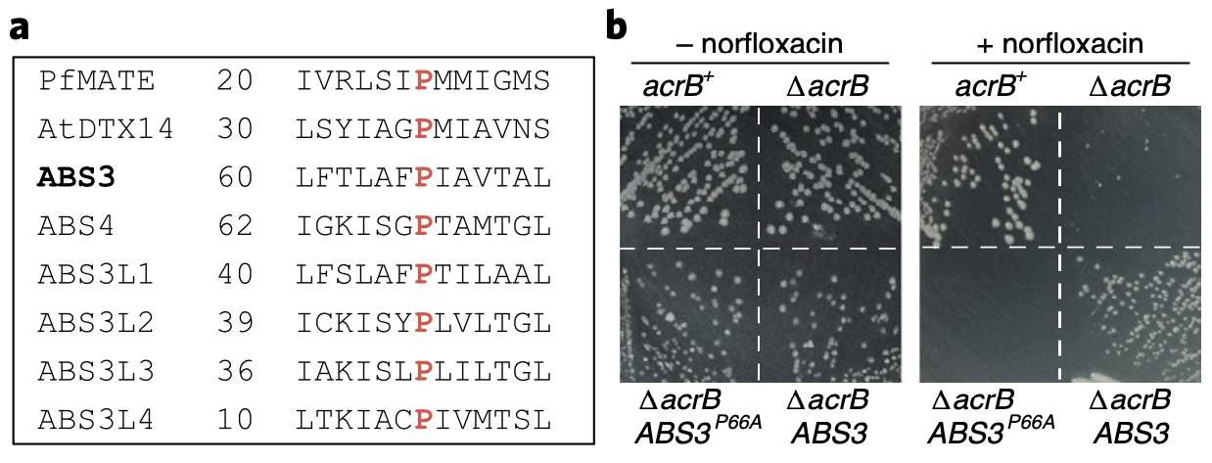
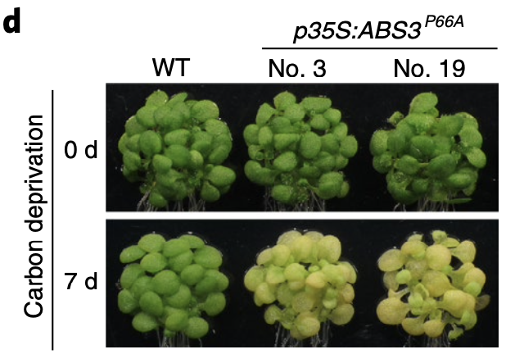
Regulation of senescence of ABS3 can be uncoupled from its transporter function
Pro66 in ABS3 is essential for transporter activity,
but dispensable for ABS3 to promote senescence.

Slide 18
ABS3 subfamily MATEs localized to the late endosome
Protoplast
Transgenic Plant Root
ABS3 subfamily MATEs
RE
LE/PVC/MVB
ARA7: Plant homolog of Rab5 GTPase,
a LE/PVC/MVB marker

Slide 19
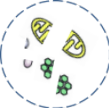
Crosstalk between endocytic and autophagic pathways
Autophagsome

Slide 20
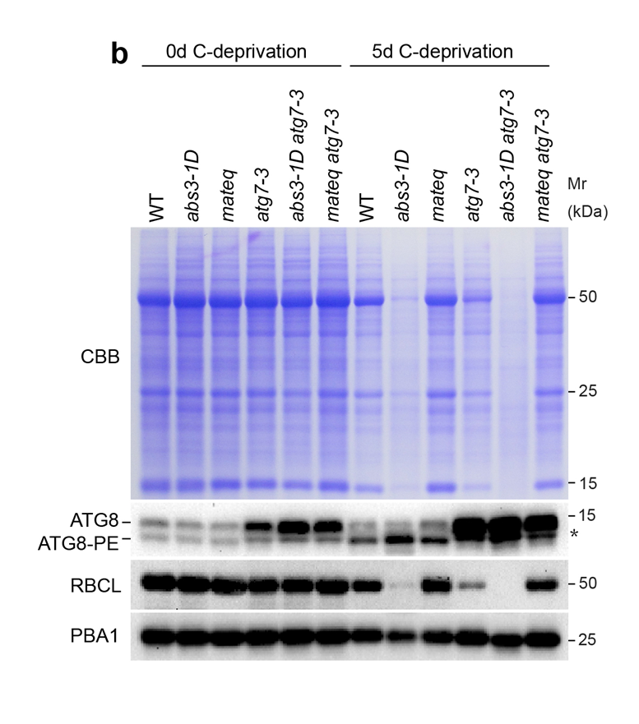
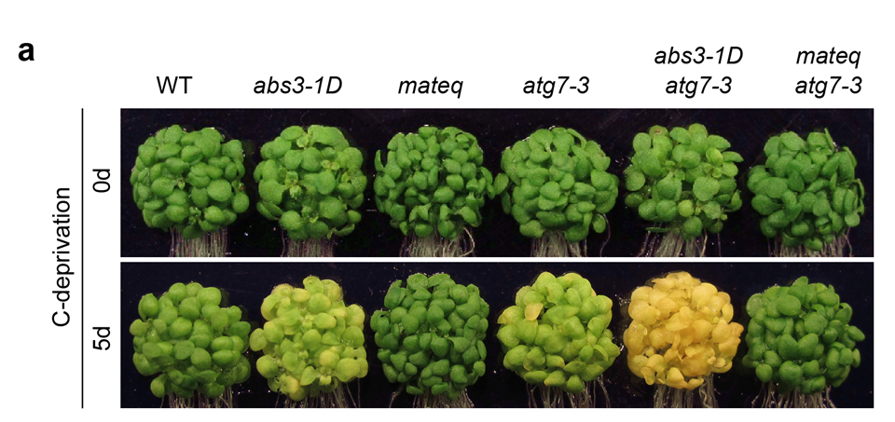
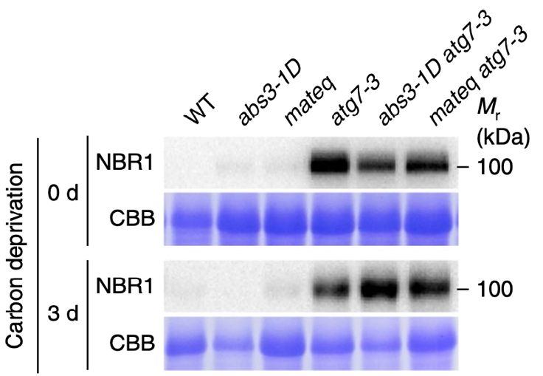
ABS3 subfamily MATEs control senescence and proteostasis independent of canonical autophagy
NBR1: cargo receptor and selective autophagy substrate

Slide 21
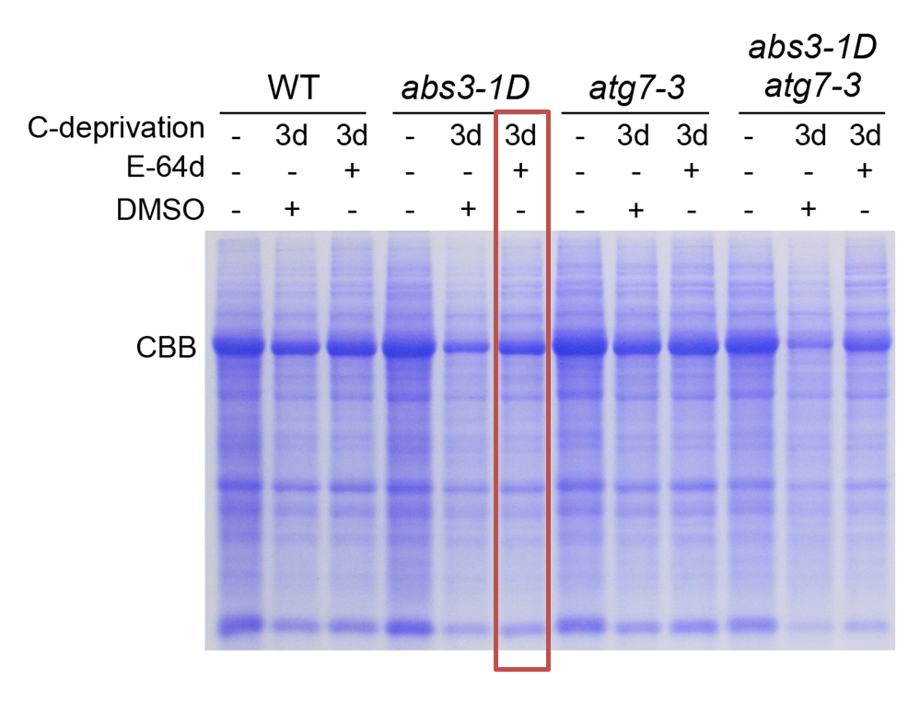
ABS3-mediated degradation is vacuole dependent
E-64d: Vacuolar cysteine protease inhibitor

Slide 22
ABS3 interacts with ATG8
Partial
co-localization
BiFC
Split-Ubiquitin
Pull-down

Slide 23
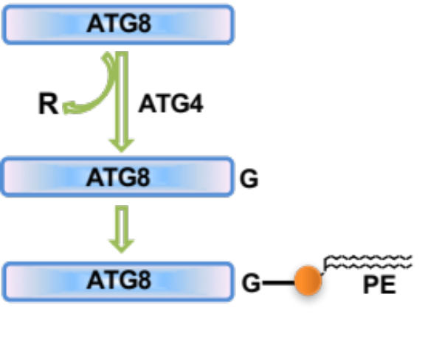
Noncanonical ATG8-ABS3 interaction
Conserved glycine in ATG8s

Slide 24
Conserved AIM1 and AIM2 in ABS3 subfamily MATEs
AIM: ATG8 Interaction Motif
 | Motif | Start | End | LIR Sequence | PSSM Score
AIM1 | WxxL | 276 | 281 | RGWAPL | 15(4.2e-02)
AIM2 | WxxL | 461 | 466 | GLWCGL | 12(1.1e-01)
AIM prediction by iLIR server.
AIM1
AIM2
ABS3 276 RGWAPLLRLAG
ABS4 278 KGWSALLSLAI
ABS3L1 256 KDWGPVVTLAI
ABS3L2 261 REWKKLLCLAI
ABS3L3 253 KGWRSLMKLAI
ABS3L4 227 RGWWPLLSLAA
ABS3 461 GLWVGLLAAQI
ABS4 463 GLWFGLLAAQA
ABS3L1 441 GLWVGLLAAQI
ABS3L2 446 GLWLGMLAAQI
ABS3L3 438 GLWLGLFAAQG
ABS3L4 412 GLWFGLLSAQM

Slide 25
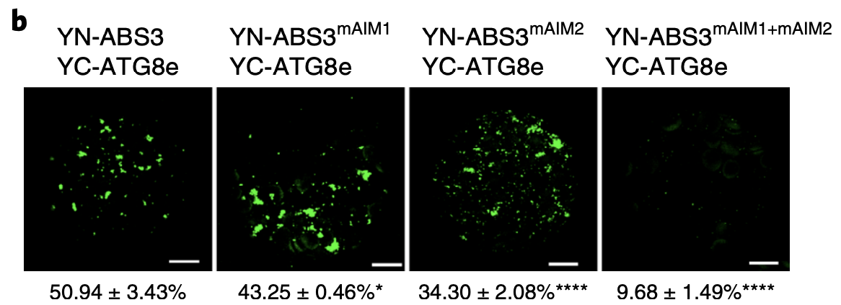
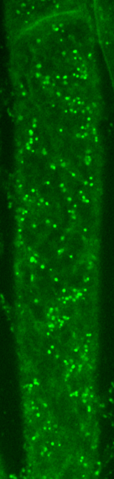
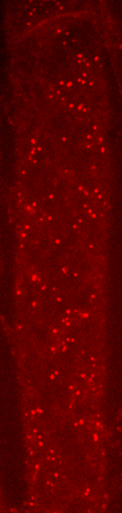
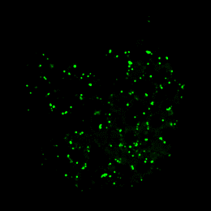
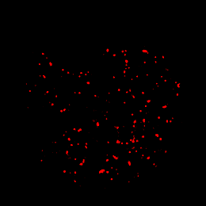
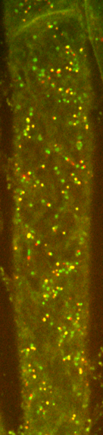
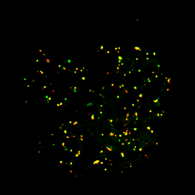

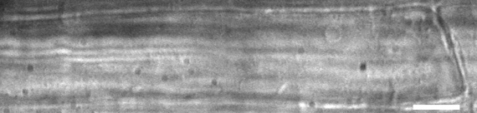
Point mutations of two AIMs abolish the interaction between ATG8 and ABS3
ABS3 ^{mAIM1+mAIM2}
-GFP
mScarlet-ARA7
ABS3 ^{mAIM1+mAIM2}-GFP
RFP-ARA7
Protoplast
Root
Merge
Merge
BF

Slide 26
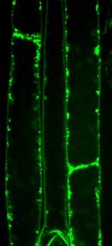
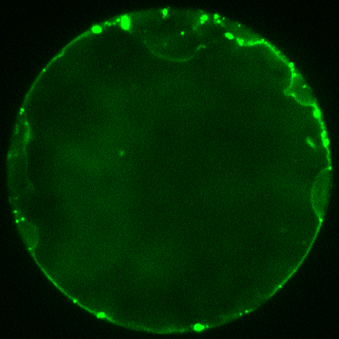
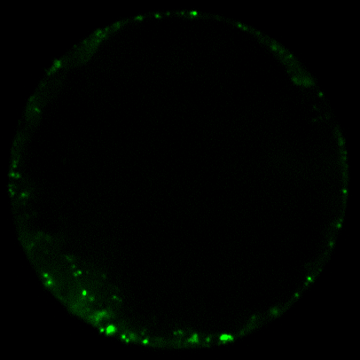
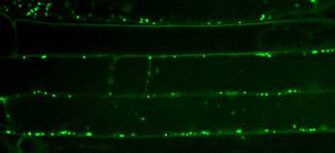
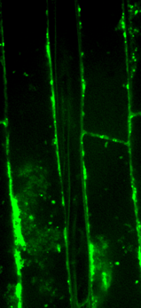
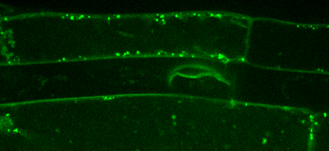
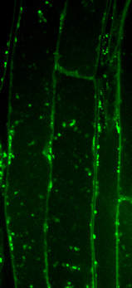





ATG8-ABS3 interaction promotes vacuole trafficking of ABS3 under C-deprivation
ABS3-GFP
ABS3^{mAIM1+mAIM2}-GFP
ABS3-GFP
ABS3^{mAIM1+mAIM2}-GFP
DMSO
DMSO
V
Control
E-64d
V
DMSO
20μM E-64d
C-deprivation
V
V
E-64d

Slide 27


ABS3-mediated senescence requires ATG8-ABS3 interaction
Overexpression of AIMs mutated ABS3^{mAIM1+mAIM2} does not accelerate senescence or protein degradation.

Slide 28
ATG8-ABS3 interaction conserved in wheat

Slide 29

Model
Jia et al., Nature Plants, Nature Plants 5, 212–224
ABS3 subfamily MATE transporters promote plant senescence.
The senescence-promoting ABS3 pathway functions in parallel with the longevity-promoting autophagy in balancing plant senescence and survival.
ATG8-ABS3 interaction at the LE represents a previously unknown non-autophagic function of ATG8 .
This ATG8-ABS3 interaction paradigm is likely conserved in crops.

Slide 30


abs3-1D suppressor screen

Slide 31

Auxin Response Factor 2 (ARF2) is required for the ABS3-mediated senescence pathway

Slide 32

ARF2 has pleiotropic functions and is not a typical ARF TF
ARF2 is involved in the regulation of flowering time, fertility, seed size, photomorphogenesis, abscisic acid signaling, and low K⁺ responses.
ARF2 may function beyond the auxin signaling pathway, microarray data indicate that auxin-regulated gene expression was largely unaffected in arf2 mutants.
Okushima et al., 2005
Wang et al., 2011

Slide 33


Overexpression of ARF2 accelerates senescence

Slide 34

Phytochrome-interacting Factor 5 (PIF5) is required for the ABS3-mediated senescence pathway

Slide 35

Overexpression of PIF5 led to accelerated senescence

Slide 36

PIF1, 3, 4, and 5 are closed related bHLH TFs share redundant roles
APB : binding sites for photoactivated phyB
APA : binding sites for photoactivated phyA
bHLH :basic helix-loop-helix
Leivar P, et al. Trends in Plant Science, 2011 Jan;16(1):19-28.

Slide 37

PIF5 and PIF4 share redundant roles in the ABS3-mediated
senescence pathway

Slide 38
abs3-1D leads to larger-scale transcription reprogramming
in carbon deprivation
4 d C-deprivation abs3-1D vs. WT: 2587 DEGs
Notes:
黑暗碳饥饿胁迫诱导衰老时，abs3-1D 导致更大规模的转录重编程。

Slide 39
ARF2 and PIF5 control the transcriptional reprogramming
in the ABS3-mediated senescence pathway
2587 DEGs : WT background (abs3-1D/WT);
arf2-20 background (arf2-20 abs3-1D/arf2-20);
pif5-10 background (pif5-10 abs3-1D/ pif5-10).

Slide 40

Significant overlapping between ARF2- and PIF5-regulated genes
ARF2-regulated
PIF5-regulated
ARF2-regulated:
abs3-1D vs. arf2-20 abs3-1D
PIF5-regulated:
abs3-1D vs. pif5-10 abs3-1D
C-deprivation-regulated:
abs3-1D 4 d vs. abs3-1D 0 d
(3,448)
(2,745)
626
358
281
1,326
1,138
780
9,784
C-deprivation-regulated
(13,028)
Notes:
为了揭示 ABS3 介导的衰老途径中 ARF2 和 PIF5 调节基因的分子特征，我们在 abs3-1D 背景中鉴定了 3,448 个 ARF2 调节基因（abs3-1D 与 arf2-20 abs3-1D）和 2,745 个 PIF5 调节基因（abs3-1D 与 pif5-10 abs3-1D），在 ARF2 调节和 PIF5 调节的基因之间观察到显著重叠（1,684 个基因）
在 abs3-1D 背景中，大多数由 ARF2 和 PIF5 共同调节的基因（1,684 个中的 1,326 个）也受 C-deprivation 调节（abs3-1D 4 d C-deprivation vs. abs3-1D 0 d C-deprivation )，并以类似的方式受 C-deprivation、ARF2 和 PIF5 的调控
由 C-deprivation、ARF2 和 PIF5 共同激活的基因子集包括许多与衰老相关的已知基因，例如 ORE1 和 SGR1
最后，我们在由 C-deprivation、ARF2 和 PIF5 共同调节的基因的启动子中鉴定了保守的过表达的顺式元件，PIF5 和 PIF4 已知的保守结合基序-G-box ，显着富集 。
表明，在黑暗碳饥饿胁迫诱导衰老时，至少有一部分 PIF5 的直接靶标也受 ARF2 调节。

Slide 41
PIF5 interacts directly with ARF2
Yeast two hybrid
BiFC
Pull-Down
Co-IP

Slide 42

PIF4 interacts directly with ARF2

Slide 43

ARF2 and PIF5 regulate senescence interdependently

Slide 44

ARF2 and PIF5 regulate senescence interdependently

Slide 45


ORE1 and SGR1 are common target genes of ARF2 and PIF5/4
ARF2 targets:
ARF2-regulated ∩ ARF2 DAP-seq
PIF5/4 targets :
PIF5-regulated ∩ (PIF5 targets ∪ PIF4 targets)
ARF2-regulated:
abs3-1D vs. arf2-20 abs3-1D
PIF5-regulated:
abs3-1D vs. pif5-10 abs3-1D
A
B
G-box: 5’-CACGTG-3’
ARF2-binding motif : 5’-TGTC-3’

Slide 46


ORE1 and SGR1 are common target genes of ARF2 and PIF5
C
D

Slide 47

PIF5 promotes cell elongation in an ARF2-independent manner

Slide 48

ARF2 requires the ABS3 subfamily MATEs to promote senescence

Slide 49

PIF5 requires the ABS3 subfamily MATEs to promote senescence

Slide 50


ARF2 negatively regulate the transcription of ABS3

Slide 51

Model
Xue et al., 2022, EMBO J, 41, e110988.
How to MATEs regulate ARF2 and PIF5?
Other components involved in the ABS3-mediated senescence pathway?

Slide 52


Acknowledgements
NSFC
State Key Laboratory of Crop Stress Biology for Arid Areas
Northwest A&F University
Former and Current Yu lab members

